Slide 1
Practical Statistics for Data science Review
Exploratory Data Analysis

Slide 2
Chapter 6
Statistical Machine Learning

Slide 3
Introduction
There is not a bright line dividing statistical learning from Machine learning. The usual difference is that:
Machine learning tends to be more focused and developing efficient algorithms that scale to a large data in order to optimize the predictive model.
Statistical learning (classical) pay more attention to the probabilistic theory and underlying structure of the model.
Machine Learning Classifiers:
K-Nearest neighbors
Tree models
Random forest
Boosting Machines

Slide 4
K- Nearest neighbors
The idea behind is very simple, for each record to be classified:
Find K records that have similar features.
Find out what the majority class is among those “similar” records and assign that class to the new records.
Mental experiment:
Predict favorite ice cream (between chocolate and vanilla) based on age, gender and K nearest neighbors.

Slide 5
Geometric interpretation
Identify who are you most similar neighbors and poll their decision to decide your guess.

Slide 6
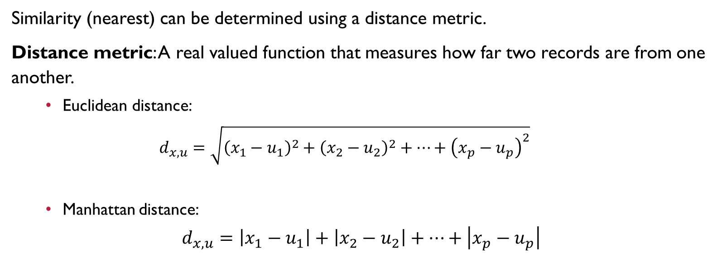
Similarity
Similarity (nearest) can be determined using a distance metric.
Distance metric: A real valued function that measures how far two records are from one another.
Euclidean distance:
$$d_{x,u}=\sqrt{{\left(x_{1}−u_{1}\right)}^{2}+{\left(x_{2}−u_{2}\right)}^{2}+…+{\left(x_{p}−u_{p}\right)}^{2}}$$
Manhattan distance:
$$d_{x,u}=\left|x_{1}−u_{1}\right|+\left|x_{2}−u_{2}\right|+…+\left|x_{p}−u_{p}\right|$$
Manhattan
Euclidean

Slide 7

Standardization “Normalization”, Z-score
Standardization puts all variables on similar scale by subtracting the mean and dividing by the standard deviation. In this way, we ensure that a variable does not overly influence a model simply by the scale of the original measurement.
$$z=\frac{x−\overline{x}}{s}$$

Slide 8
KNN summary
KNN classifies a record by assigning it to the class that similar records belong to.
Similarity is determined by Euclidean distance or other metrics.
The predictor variables are standardized to that the variables of large scale do not dominate the distance metrics.
K is determined by how well the algorithm performs on training data using different values for K (trail and error).
KNN is often used as first stage in predictive modeling, and its result is added to the data as a new predictor for a second stage for non-KNN modeling.

Slide 9
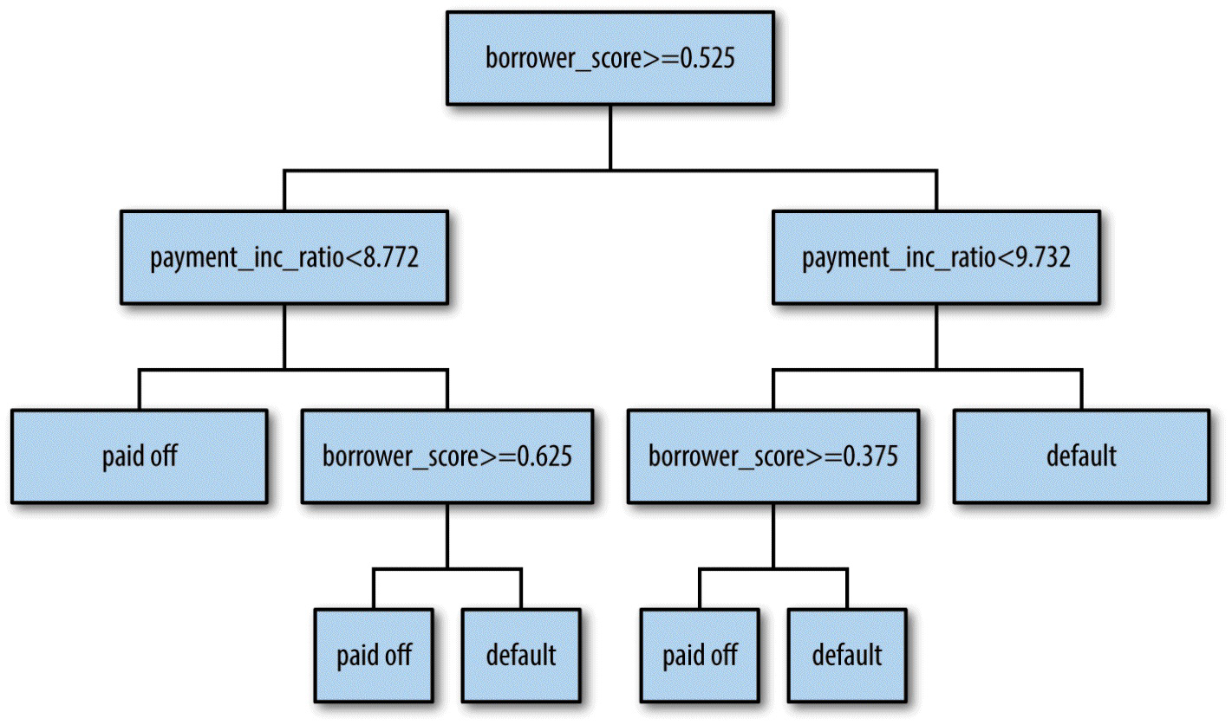
Tree Models Decision trees
Developed by Leo Breiman in 1984.
Is a set of “if-then-else” rules that are easy to understand and to implement.
Can discover hidden patterns corresponding to complex interactions in the data.

Slide 10
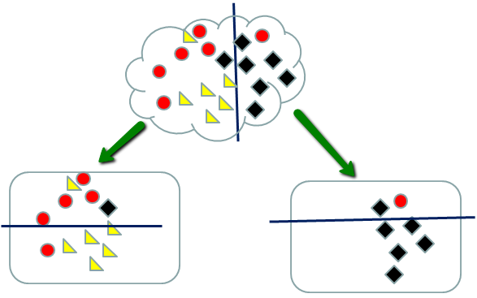
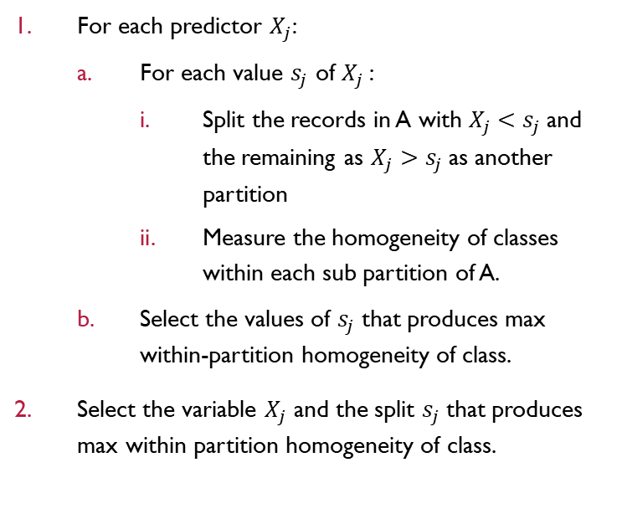
Recursive Partitioning algorithm
To construct a decision tree, we use the recursive partitioning algorithm, the data is repeatedly partitioned using predictor values that do the vest job separating the data into relatively homogeneous partition.
For each predictor $X_{j}$:
For each value $s_{j}$ of $X_{j}$:
Split the records in A with $X_{j}<s_{j}$and the remaining as $X_{j}>s_{j}$as another partition
Measure the homogeneity of classes within each sub partition of A.
Select the values of $s_{j}$that produces max within-partition homogeneity of class.
Select the variable $X_{j}$ and the split $s_{j}$that produces max within partition homogeneity of class.

Slide 11
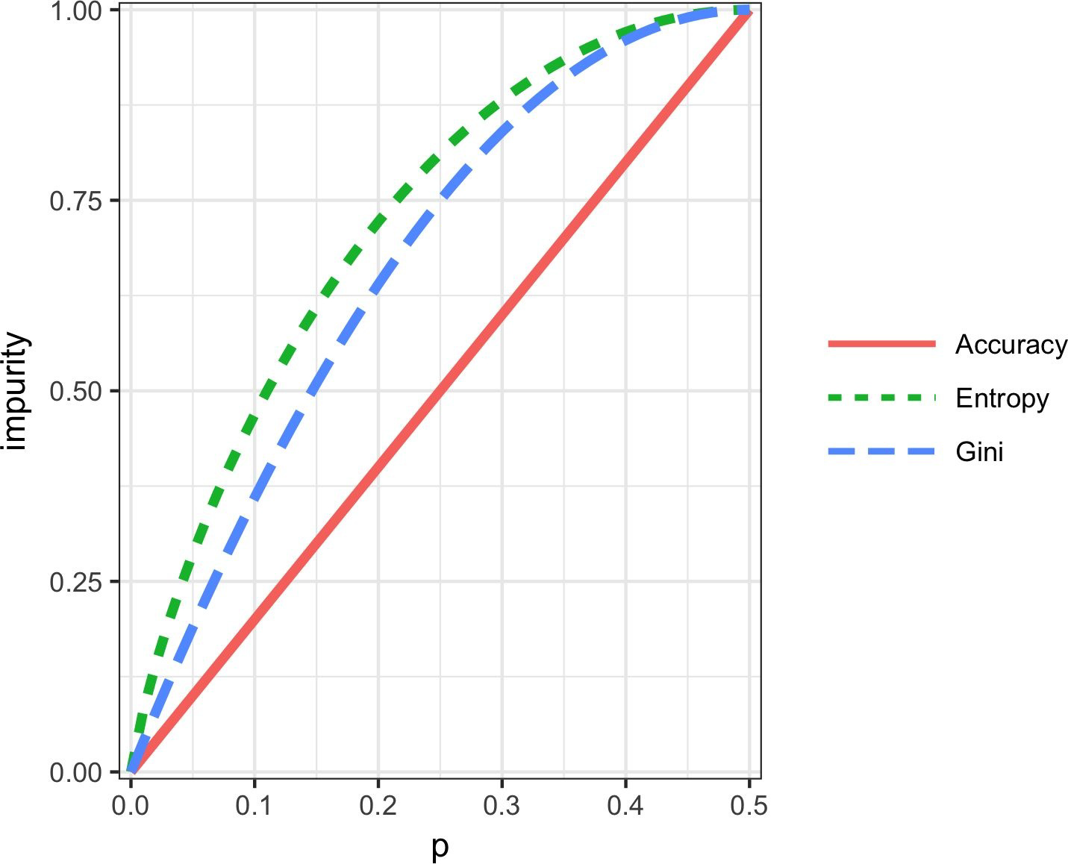
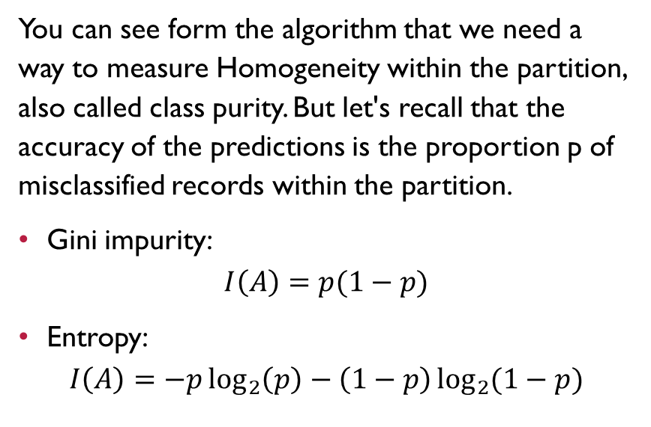
*Measuring Homogeneity and Impurity
You can see form the algorithm that we need a way to measure Homogeneity within the partition, also called class purity. But let's recall that the accuracy of the predictions is the proportion p of misclassified records within the partition.
Gini impurity:
$$I\left(A\right)=p(1−p)$$
Entropy:
$$I\left(A\right)=−p\log_{2}\left(p\right)−\left(1−p\right)\log_{2}{(1−p)}$$

Slide 12
Decision trees Summary
Decision trees produce a set of rules (if/else) to classify or predict an outcome.
The rules correspond to successive partitioning of the data into sub partitions or splits.
Each split divides the data into records that are below or above the split value.
At each stage, the tree algorithm chooses the split that minimizes the outcome impurity within each sub partition.
When no further splits can be made, the tree is fully grown, and each leaf has records of a single class. New cases following that set of rules would be assigned to that class.
A fully grown tree overfits the data and must be pruned back to avoid capturing noise.

Slide 13





Model ensemble
Ensemble: Forming a prediction by using a collection of models.
Develop a predictive model and record the prediction for a given dataset.
Repeat for multiple models, on the same data.
For each record to be predicted, take and average ( or majority vote) of the predictions.

Slide 14
Bagging
Bagging: Build multiple learners in parallel and combine predictions using an averaging or a majority-vote strategy (Bootstrapping)
Bagging is like the basic algorithm for ensembles but instead of fitting the various models to the same data each new model is fit to a bootstrap resample.
1
2
3

Slide 15



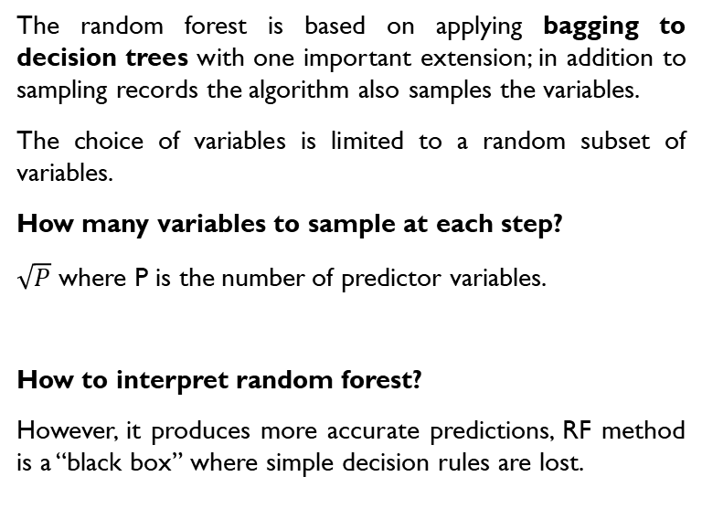
Random Forest
The random forest is based on applying bagging to decision trees with one important extension; in addition to sampling records the algorithm also samples the variables.
The choice of variables is limited to a random subset of variables.
How many variables to sample at each step?
$\sqrt{P}$ where P is the number of predictor variables.
How to interpret random forest?
However, it produces more accurate predictions, RF method is a “black box” where simple decision rules are lost.
1
2
3

Slide 16



Boosting
Boosting: Build learners sequentially and combine using a weighted averaging strategy.
This model change the paradigm to an optimization problem where the algorithm forces the models to train more heavily on the data for which it performed poorly.
Boosting vs Bagging
“If these two methods were cars, bagging could be considered a Honda Accord (reliable and steady), whereas boosting could be considered a Porsche (powerful but requires more care) ”
XGBoost is the most widely used software for boosting trees.
1
2
3

Slide 17
Summary

